Slide 1
Hydrogen Bonding
Hybridization
Ionic Bonding
Resonance
Vander Waals Forces (London Dispersion)
1. Is used to explain why iodine molecules are held together in the solid state.
2. Is used to explain why the boiling point of HF is greater than the boiling point of HBr.
3. Is used to explain the fact that the four bonds in methane are equivalent.
4. Is used to explain the fact that the carbon-carbon bond in benzene C₆H₆ are identical.

Slide 2
11. E
12. A
13. B
14. D

Slide 3
5. Which of the following is true at the triple point of a pure substance
The vapor pressure of the solid phase always equals the vapor pressure of the liquid phase.
The temperature is always 0.01K lower than the normal boiling point.
The liquid and gas phase of the substance always have the same density and are therefore indistinguishable
The solid phase always melts if the pressure increases at constant temperature
The liquid phase always vaporizes if the pressure increases at constant temperature.

Slide 4
5) A

Slide 5
32. CH3CH2OH boils at 78_C and CH3OCH3 boils at –24_C, although both compounds have the same composition. This difference in boiling points may be attributed to a difference in
(A) molecular mass (B) density
(C) specific heat (D) hydrogen bonding
(E) heat of combustion

Slide 6
d

Slide 7
34. X CH3–CH2–CH2–CH2–CH3
Y CH3–CH2–CH2–CH2–OH
Z HO–CH2–CH2–CH2–OH
Based on concepts of polarity and hydrogen bonding, which of the following sequences correctly lists the compounds above in the order of their increasing solubility in water?
(A) Z < Y < X (B) Y < Z < X
(C) Y < X < Z (D) X < Z < Y
(E) X < Y < Z

Slide 8
E

Slide 9
27. I. Difference in temperature between freezing point of solvent and freezing point of solvent and freezing point of solution
II. Molal freezing point depression constant, Kƒ, for solvent
In addition to the information above, which of the following gives the minimum data required to determine the molecular mass of a nonionic substance by the freezing point depression technique?
a. No further information is necessary.
b. Mass of solute
c. Mass of solute and mass of solvent
d. Mass of solute and volume of solvent
e. Mass of solute, mass of solvent, and vapor pressure of solvent

Slide 10
C

Slide 11
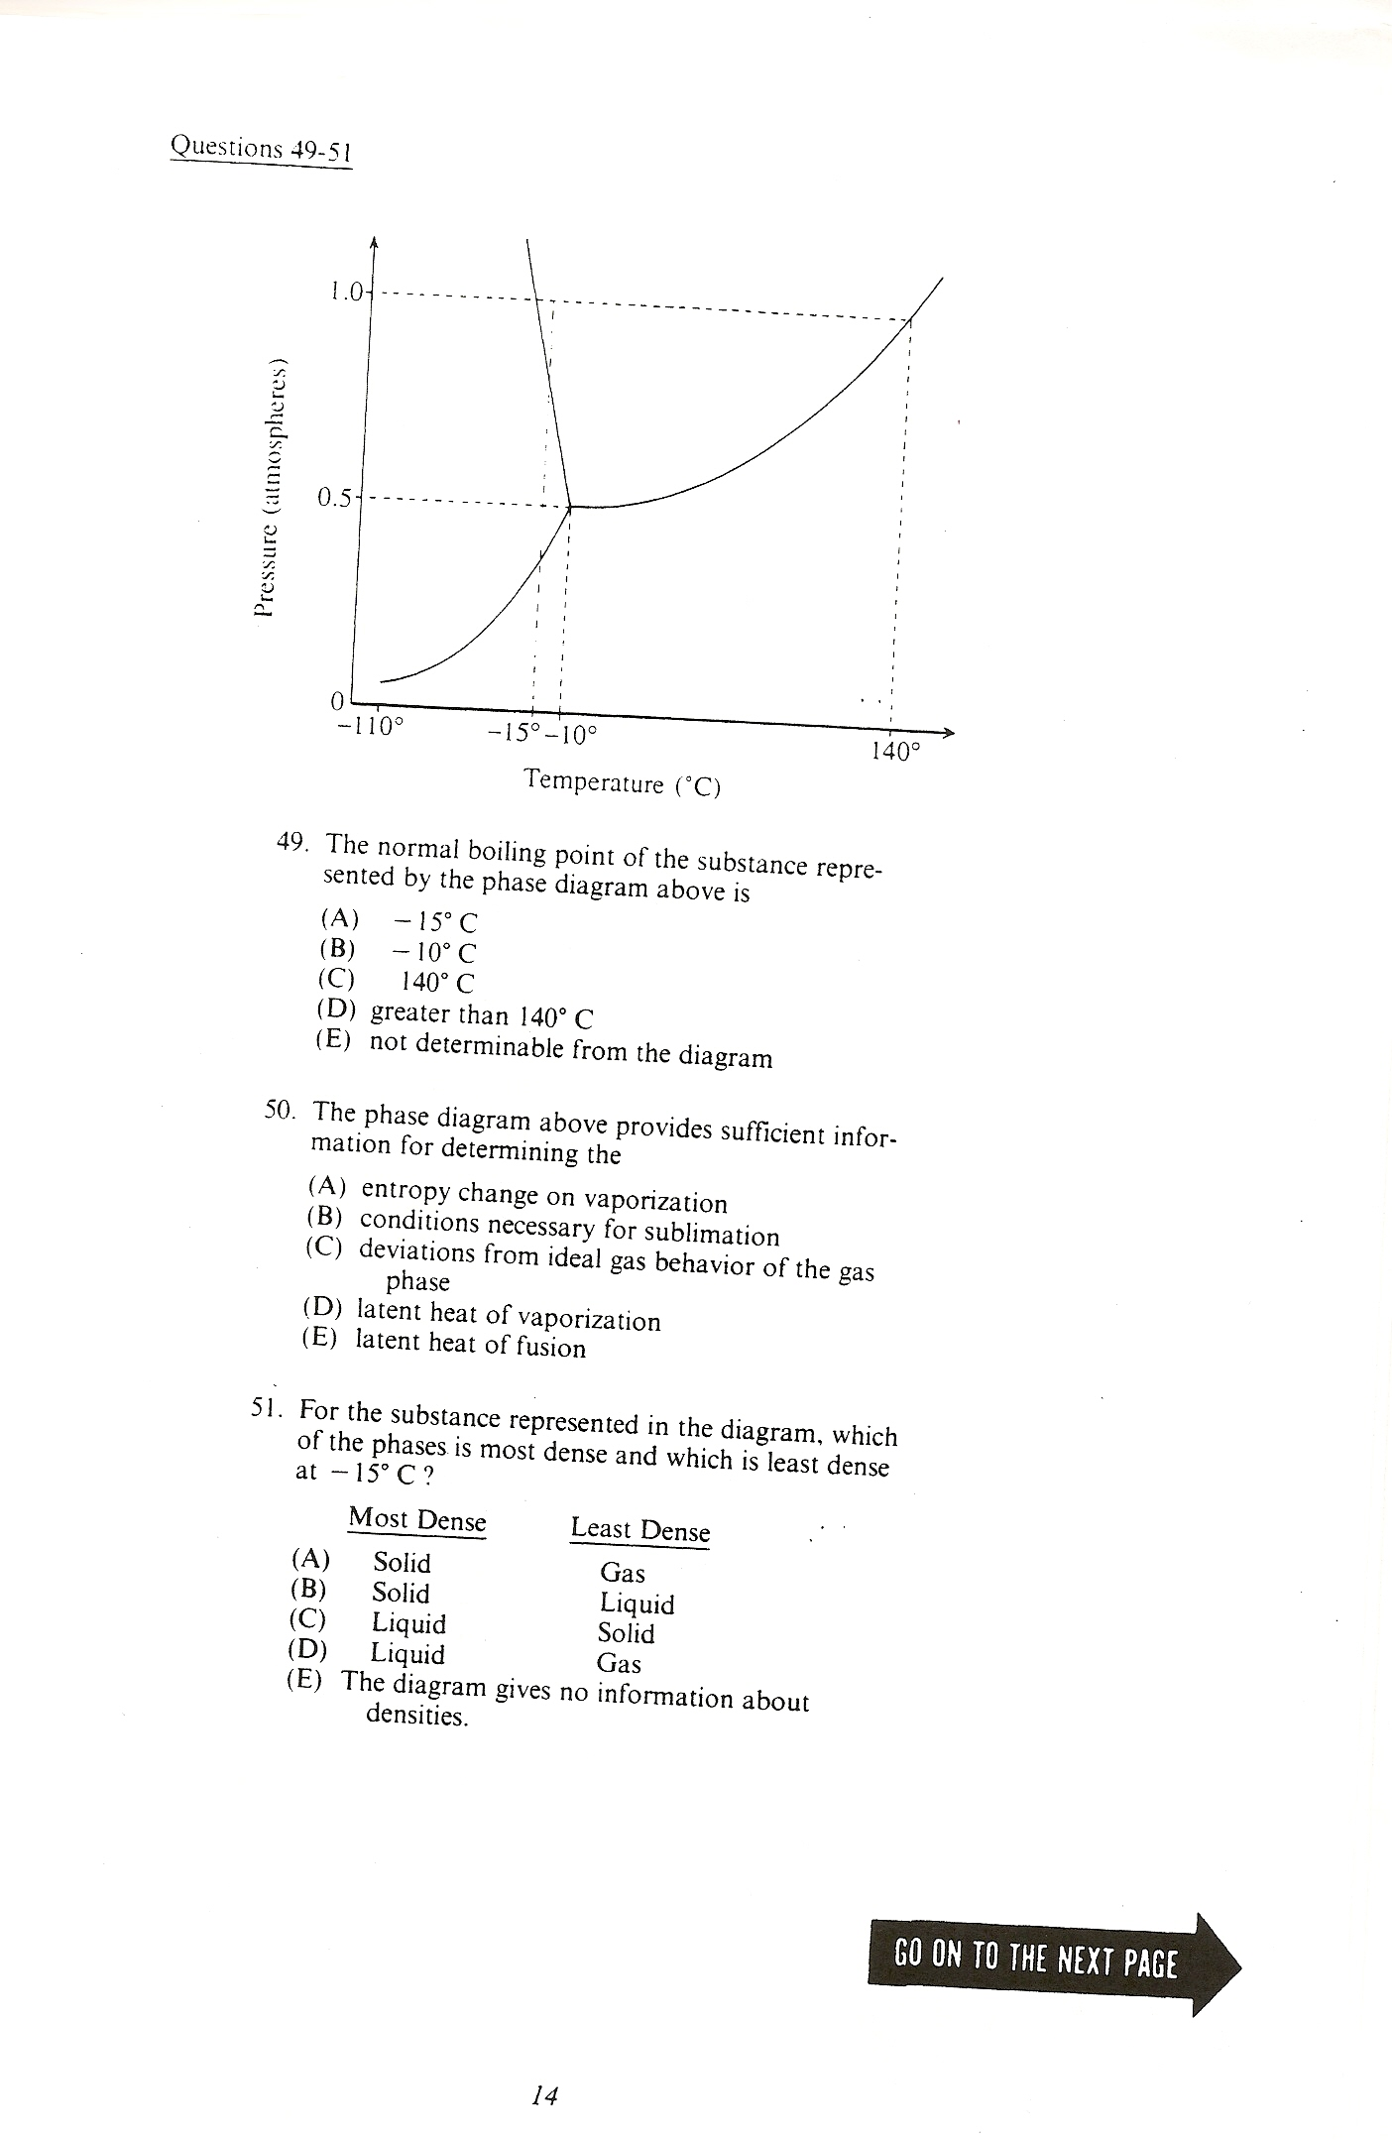

Slide 12
49) C
50) B
51) D

Slide 13
Lattice of positive and negative ions held together by electrostatic forces.
Closely packed lattice with delocalized electrons throughout
Strong single covalent bonds with weak intermolecular forces.
Strong multiple covalent bonds (including pi-bonds) with weak intermolecular forces.)
Macromolecules held together with strong polar bonds.
13. Cesium Chloride, CsCl (s)
14. Gold, Au (s)
15. Carbon Dioxide, CO₂
16. Methane, CH₄

Slide 14
13) A
14) B
15) D
16) C

Slide 15
In which of the following are covalent bonds broken?
I₂(s) → I₂(g)
CO₂(s) → CO₂(g)
NaCl(s) → NaCl (l)
C(diamond) → C(g)
Fe(s) → Fe(l)

Slide 16
d

Slide 17
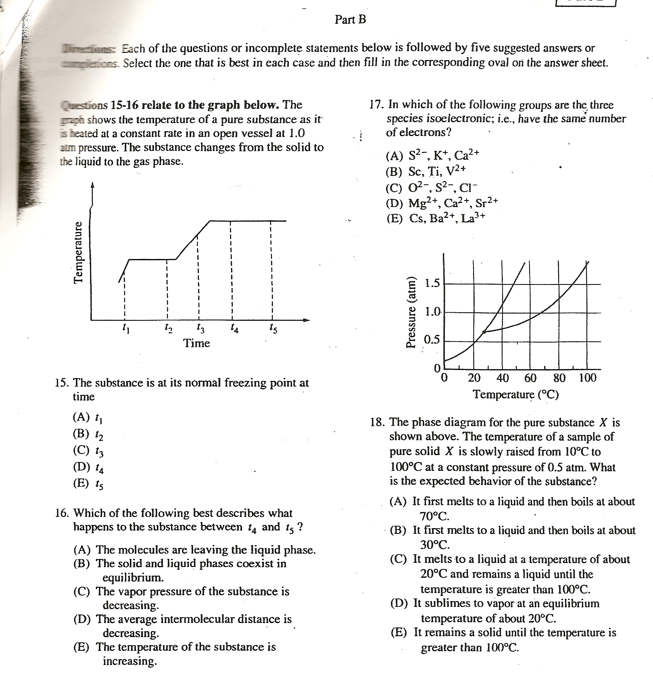

Slide 18
B
A
A
d

Slide 19
The best explanation for the fact that diamond is extremely hard is that diamond crystals
Are made up of atoms that are intrinsically hard because of their electronic structures.
Consist of positive and negative ions that are strongly attracted to each other
Are giant molecules in which each atom forms strong covalent bonds with all of its neighboring atoms
Are formed under extreme conditions of temperature and pressure
Contain orbitals or bands of delocalized electrons that belong not to single atoms but to each crystal as a whole

Slide 20
c

Slide 21
The boiling points of the elements He, Ne, Ar, Kr and Xe increase in that order. Which of the following statements accounts for this increase?
The London (dispersion) forces increase
The Hydrogen Bonding increases
The dipole-dipole forces increase.
The chemical reactivity increases.
The number of nearest neighbors increases.

Slide 22
a

Slide 23
14. Which of the following is lower for a 1.0–molar aqueous solution of any solute than it is for pure water?
(A) pH
(B) Boiling Point
(C) Freezing point
(D) Electrical conductivity
(E) Absorption of visible light

Slide 24
C

Slide 25
26. Which of the following actions would be likely to change the boiling point of a sample of a pure liquid in an open container?
I. Placing it in a smaller container
II. Increasing the number of moles of the liquid in the container
III. Moving the container and liquid to a higher altitude
(A) I only (B) II only
(C) III only (D) II and III only
(E) I, II, and III

Slide 26
c

Slide 27
28. Given that a solution is 5 percent sucrose by mass, what additional information is necessary to calculate the molarity of the solution?
I. The density of water
II. The density of the solution
III. The molar mass of sucrose
(A) I only (B) II only (C) III only
(D) I and III (E) II and III

Slide 28
e

Slide 30
2003 D Required
For each of the following, use appropriate chemical principles to explain the observations. Include chemical equations as appropriate.
(a) In areas affected by acid rain, statues and structures made of limestone (calcium carbonate) often show signs of considerable deterioration.
(b) When table salt (NaCl) and sugar (C12H22O11) are dissolved in water, it is observed that
(i) both solution have higher boiling points than pure water, and
(ii) the boiling point of 0.10 M NaCl(aq) is higher than that of 0.10 M C12H22O11(aq).
(c) Methane gas does not behave as an ideal gas at low temperatures and high pressures.
(d) Water droplets form on the outside of a beaker containing an ice bath.

Slide 31
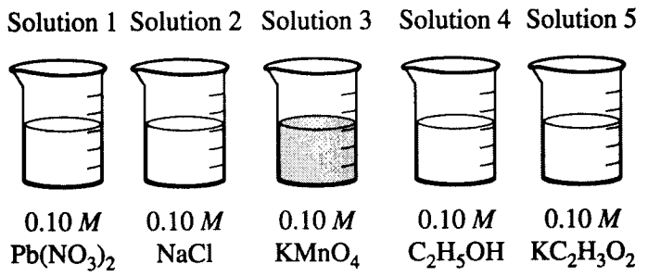
2001 D Required
Answer the questions below that relate to the five aqueous solutions at 25°C shown above.
(a) Which solution has the highest boiling point? Explain.
(b) Which solution has the highest pH? Explain.
(c) Identify a pair of the solutions that would produce a precipitate when mixed together. Write the formula of the precipitate.
(d) Which solution would be the least effective conductor of electricity? Explain.

Slide 32
2000 D Required
The molar mass of an unknown solid, which is nonvolatile and a nonelectrolyte, is to be deter­mined by the freezing-point depression method. The pure solvent used in the experiment freezes at 10°C and has a known molal freezing-point de­pression constant, Kƒ. Assume that the following materials are also available.
• test tubes • stirrer • pipet
• stopwatch • graph paper
• thermometer • balance • beaker
• ice • hot-water bath
(a) Sketch the cooling curves for (i) the pure solvent and for (ii) the solution as each is cooled from 20°C to 0.0°C
(b) Information from these graphs may be used to de­termine the molar mass of the unknown solid.
  Describe the measurements that must be made to determine the molar mass of the unknown solid by this method.
(ii) Show the setup(s) for the calculation(s) that must be performed to determine the molar mass of the unknown solid from the experi­mental data.
(iii) Explain how the difference(s) between the two graphs in part (a) can be used to obtain information needed to calculate the molar mass of the unknown solid.
(c) Suppose that during the experiment a significant but unknown amount of solvent evaporates from the test tube. What effect would this have on (he calculated value of the molar mass of the solid (i.e., too large, too small, or no effect)? Justify your answer.
(d) Show the setup for the calculation of the percent­age error in a student’s result if the student obtains a value of 126 g mol-1 for the molar mass of the solid when the actual value is 120. g mol-1.

Slide 33
1998 B
An unknown compound contains only the three elements C, H, and O. A pure sample of the compound is analyzed and found to be 65.60 percent C and 9.44 percent H by mass.
Determine the empirical formula of the compound.
A solution of 1.570 grams of the compound in 16.08 grams of camphor is observed to freeze at a temperature 15.2 Celsius degrees below the normal freezing point of pure camphor. Determine the molar mass and apparent molecular formula of the compound. (The molal freezing-point depression constant, Kâ, for camphor is 40.0 kg•K•mol-1.)
When 1.570 grams of the compound is vaporized at 300°C and 1.00 atmosphere, the gas occupies a volume of 577 milliliters. What is the molar mass of the compound based on this result?
(d) Briefly describe what occurs in solution that accounts for the difference between the results obtained in parts (b) and (c).

Slide 34
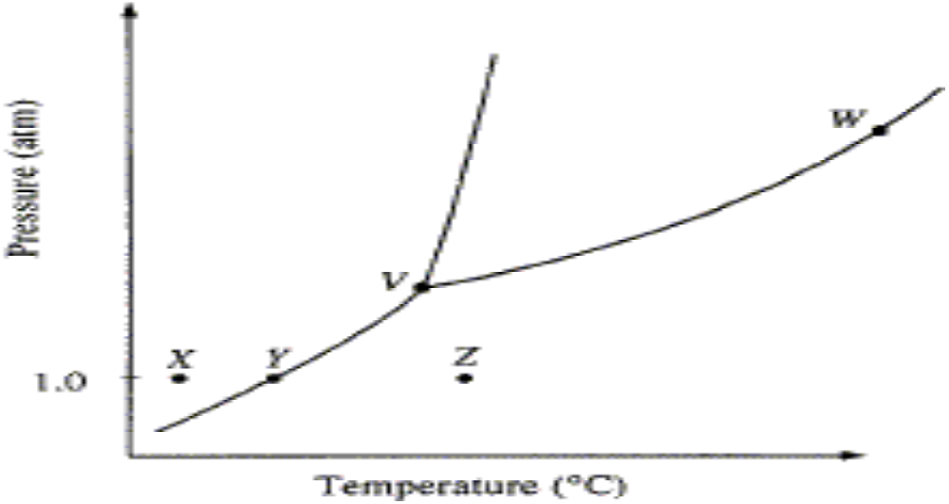
The phase diagram for a pure substance is shown above. Use this diagram and your knowledge about changes of phase to answer the following questions.
(a) What does point V represent? What characteristics are specific to the system only at point V?.
(b) What does each point on the curve between V and W represent?
(c) Describe the changes that the system undergoes as the temperature slowly increases from X to Y to Z at 1.0 atmosphere.
(d) In a solid-liquid mixture of this substance, will the solid float or sink? Explain.

Slide 35
(a) A solution containing 3.23 grams of an unknown compound dissolved in 100.0 grams of water freezes at -0.97°C. The solution does not conduct electricity. Calculate the molecular weight of the compound. (The molal freezing point depression constant for water is 1.86°C kg mole-1)
(b) Elemental analysis of this unknown compound yields the following percentages by weight H=9.74%; C=38.70%; O=51.56%. Determine the molecular formula for the compound.
(c) Complete combustion of a 1.05 gram sample of the compound with the stoichiometric amount of oxygen gas produces a mixture of H2O(g) and CO2(g). What is the pressure of this gas mixture when it is contained in a 3.00 liter flask at 127°C?

